Slide 1

WIPRO NGA Program - 24NAG1271 Batch
Capstone Project Presentation – 26 August 2024
Project Title Here – Online Flight Ticket Booking System
Presented by – CPPE 3
www.rpsconsulting.in

Slide 2

Project Overview
Online Flight Ticket Booking System is a web application that helps the commuters to book flight ticket online.
In order to book ticket, the commuter has to register himself by filling up the details. Once the user had registered himself he has to login in order to book the ticket.
While booking the user has to select the type of airlines he will be travelling and he has to specify the place he is going to travel between.
According to the type of airlines and place, the system will provide information regarding flight and venue which are available on the date specified by the Commuter.
Commuter will be able to view the details related to his bookings.
For convenience if the commuter wants to change the date of his flight he/she is able to change it.
Happy Journey.
2024 - RPS Consulting all rights reserved

Slide 3
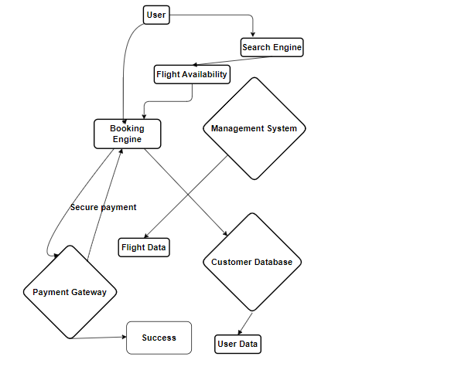
Architecture
2024 - RPS Consulting all rights reserved

Slide 4
Project Flow
Login Page & Registration
Book the Flight by selecting Source location, destination location, Preferred date & class.
Search for the flight & book it.
Make Payment.
If payment is completed then your flight is booked successfully.
For making any changes go to flight details tab and proceed further by editing the details.
Make desirable changes.
Happy Journey.
2024 - RPS Consulting all rights reserved

Slide 5
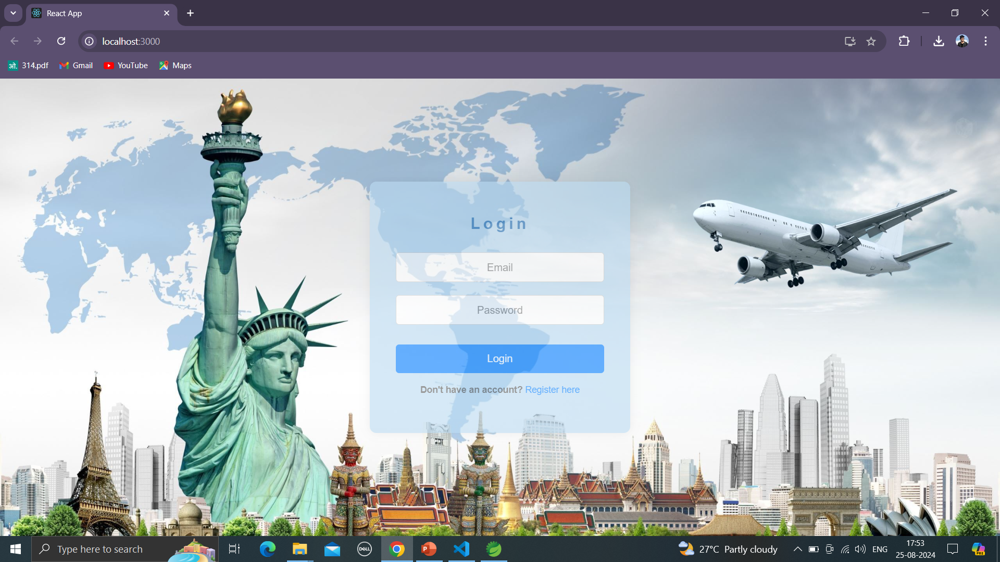
Screenshots
Login Page
2024 - RPS Consulting all rights reserved

Slide 6
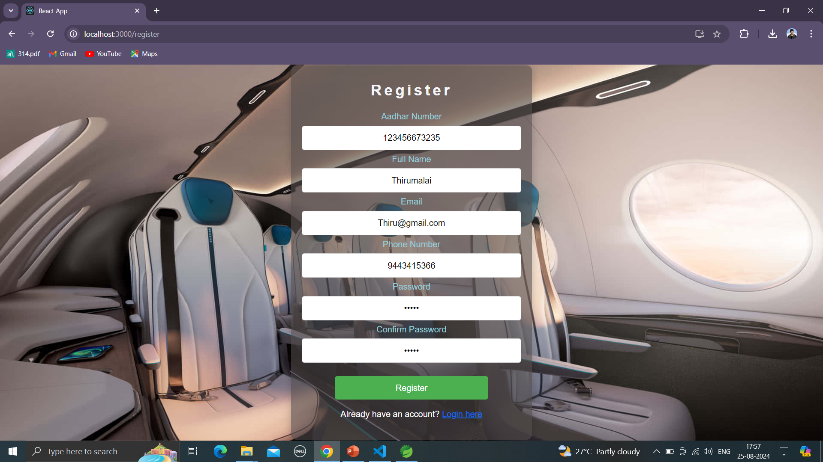
Screenshots
Register Page
2024 - RPS Consulting all rights reserved

Slide 7
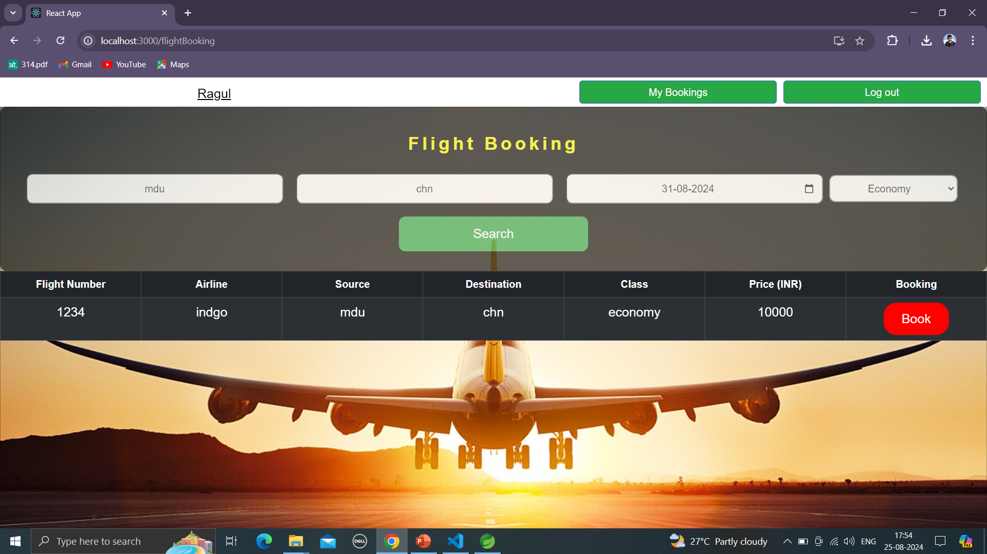
Screenshots
Flight Booking Page
2024 - RPS Consulting all rights reserved

Slide 8
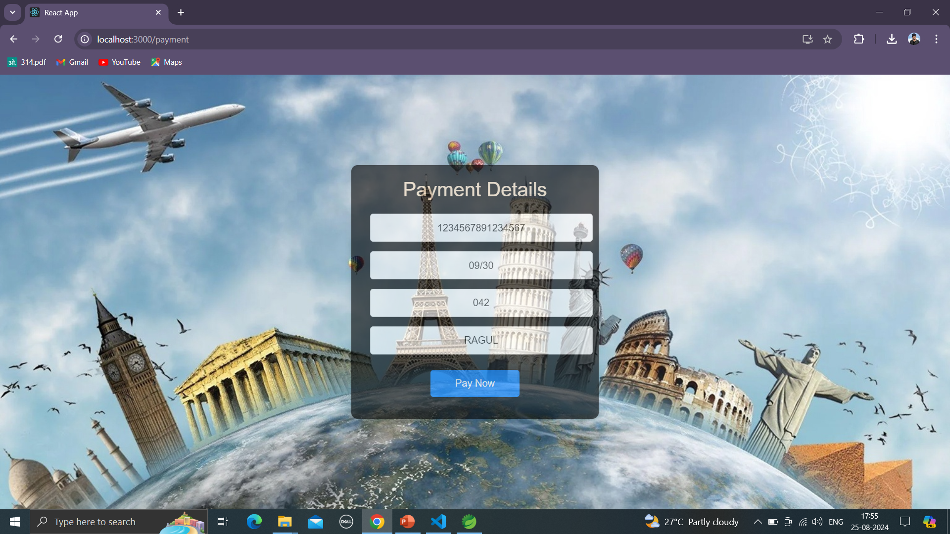
Screenshots
Payment Page
2024 - RPS Consulting all rights reserved

Slide 9
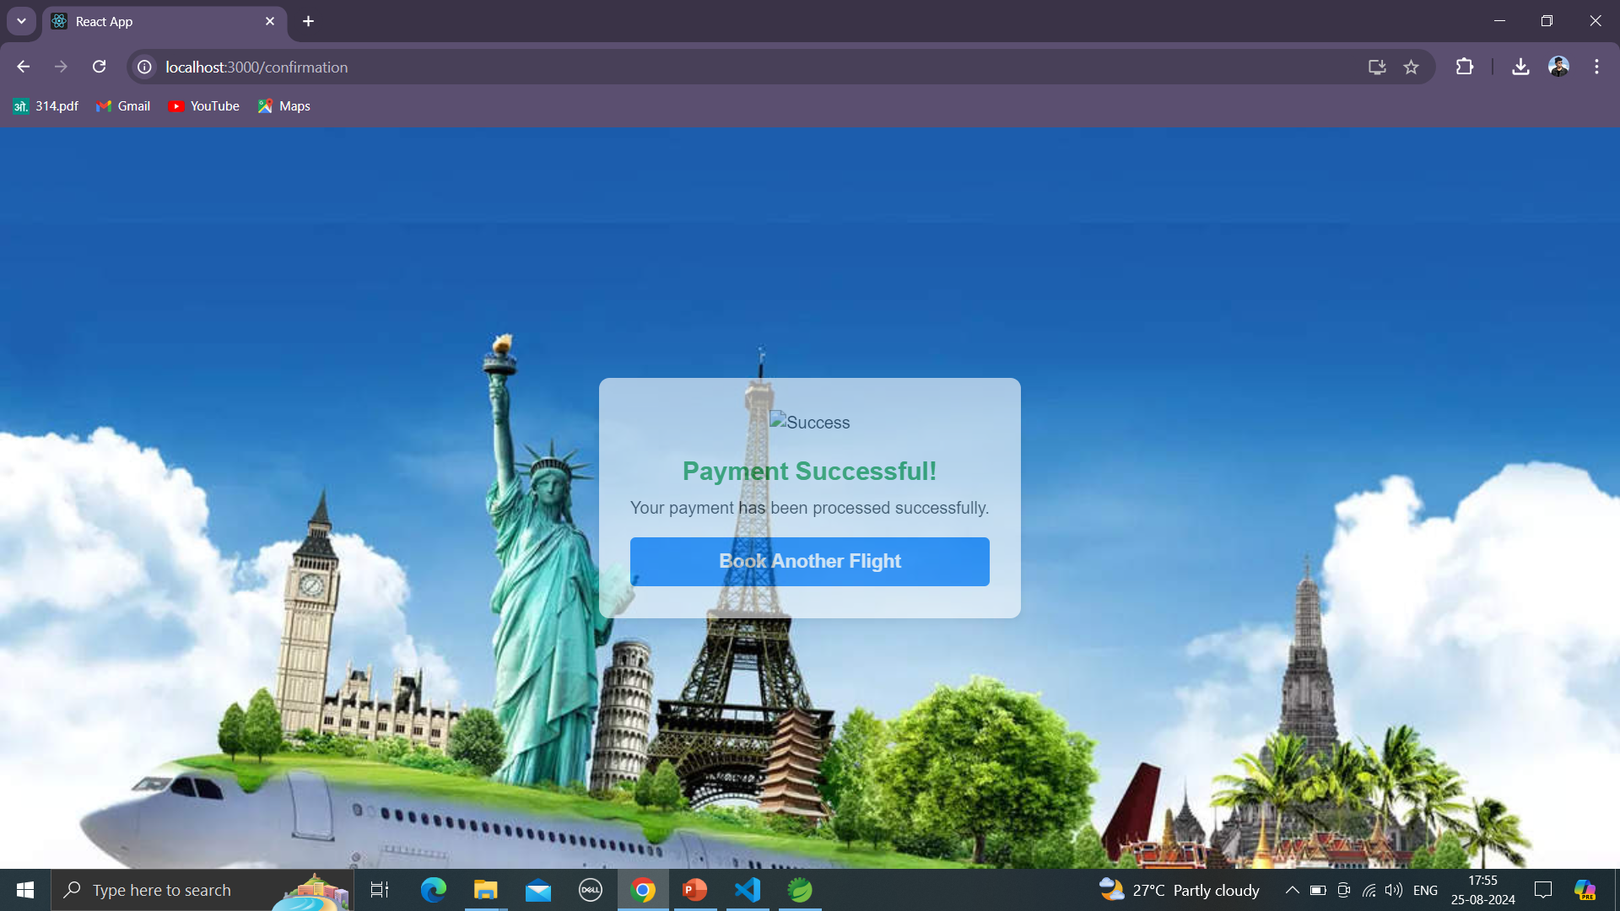
Screenshots
Success Page
2024 - RPS Consulting all rights reserved

Slide 10
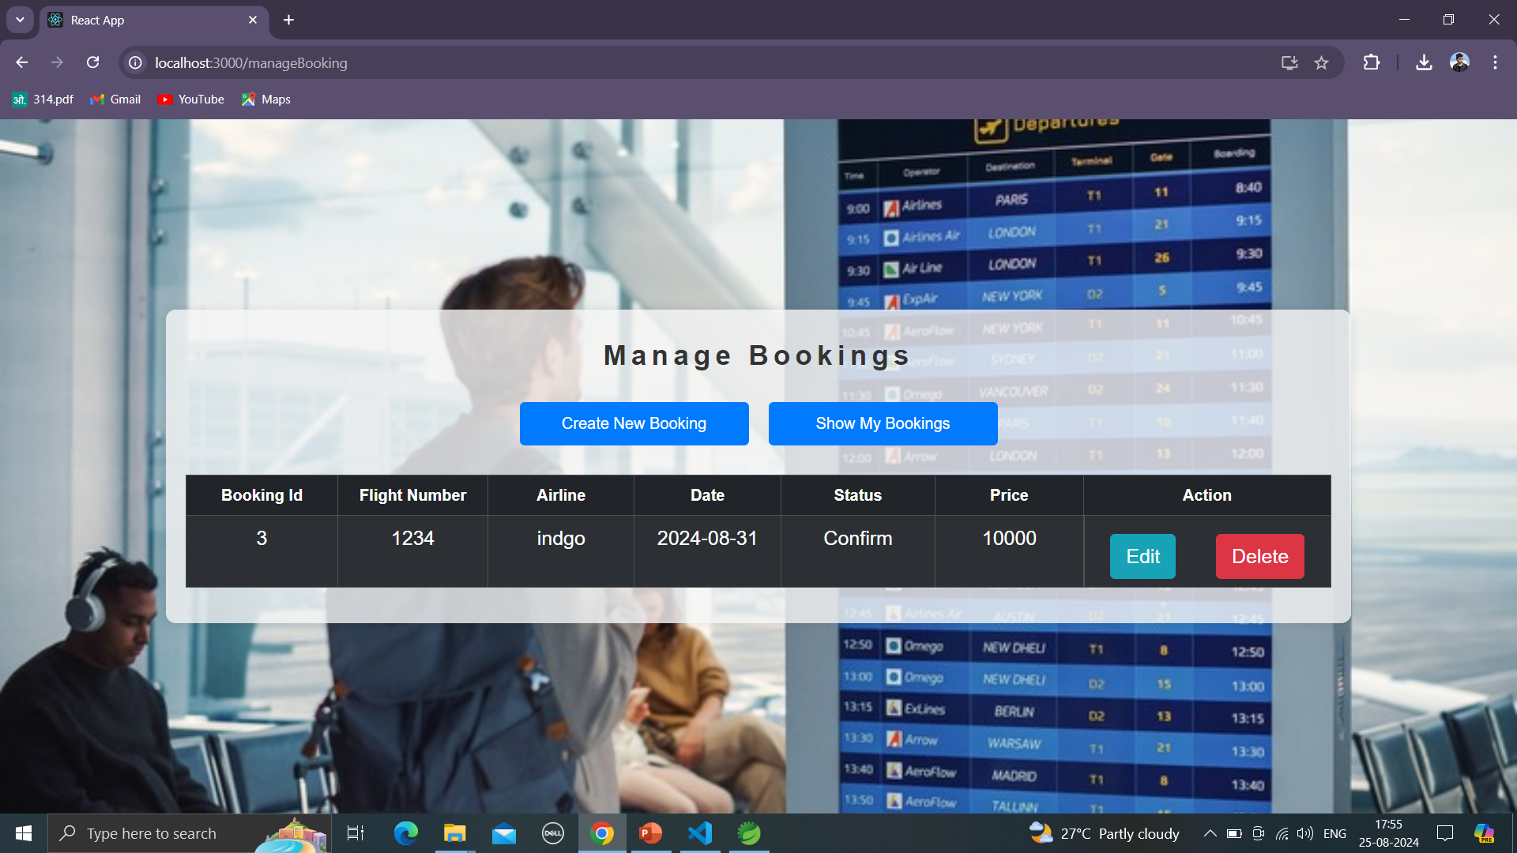
Screenshots
Manage Flight Booking Page
2024 - RPS Consulting all rights reserved

Slide 11
Software Details
Front End : React JS
Editor : Visual Studio Code
Back End : JAVA & SQL
Editor : Spring Tool Suite 4 & MySQL workbench
2024 - RPS Consulting all rights reserved

Slide 12
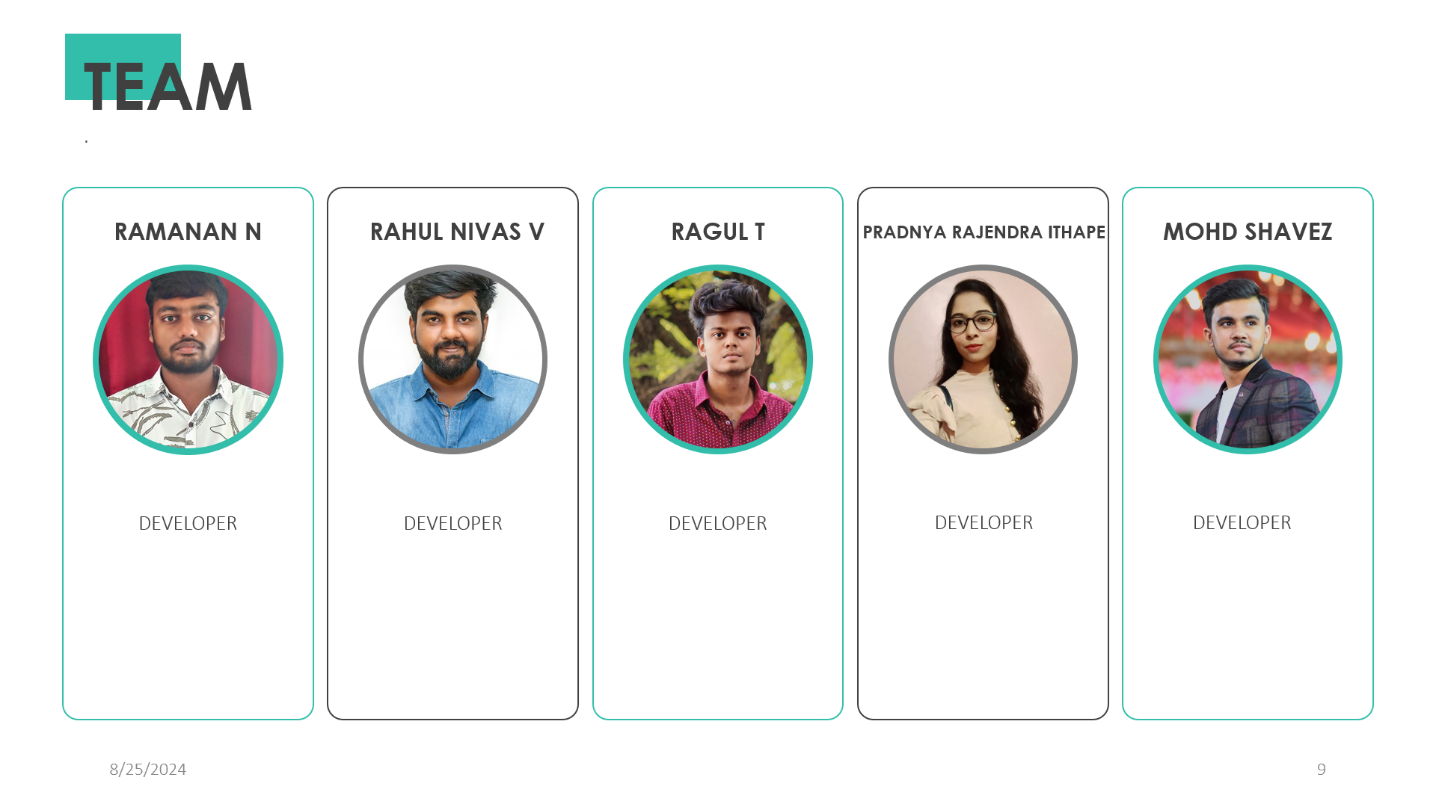
2024 - RPS Consulting all rights reserved

Slide 13
References
https://react.dev/learn
https://spring.io/projects/spring-boot#learn
https://dev.mysql.com/doc/mysql-tutorial-excerpt/8.0/en/
https://dev.java/learn/
2024 - RPS Consulting all rights reserved

Slide 14
Thank You…
2024 - RPS Consulting all rights reserved

